Slide 1
Interview event for Global Majority Applicants Reflection, Race and Interviews
5th March 2024.
Notes:
Tansy to introduce the day

Slide 2
Introductions and plan for the session
Hello!
A brief introduction to who we are and why we feel it’s important to be here today
Plan!
Spend some time looking at a powerpoint, have a break in the middle and a Q&A with staff and trainees.
Notes:
Tansy

Slide 3
Aims for the event
Provide an overview of the interview process
Share skills and tips for interviews
To unpick what we mean by ‘reflection’
Explore how to be authentic in interviews
Q&A with staff and trainees
By the end of the session it is hoped you will have gathered a good understanding of the process of DClinPsy interviews. We will explore what is meant by reflection, consider how you can bring reflective skills into your interviews and for you to feel empowered to reflect on your identity.
Notes:
Maya – bullet
Ruth – paragraph

Slide 4
The DClin Interviews
(A brief reminder)
Notes:
Liza

Slide 5
Key facts:
There are 30 courses
Courses shortlist and interview in various ways therefore it’s not possible to give a prescriptive description
Clinical interview, research interview, EbE interview
Panels course team members, local clinicians, supervisors, trainees, EbE, service user
Many online or hybrid
Usually trainees available on the day
Notes:
Liza

Slide 6
Interviews
Clinical interview: focuses on clinical and professional work experience and formulations
Can include a presentation of a prepared answer
Can include engagement in a short role play or clinical exercise
Can include being asked to read a vignette and provide some reflections or formulations
Can include questions on clinical practice
Research/academic interview: will focus mainly on your knowledge of research, service evaluations and academic issues
You may be asked how you would research or evaluate something
You may be asked to summarise or evaluate a research paper
May include a presentation of a prepared answer
Notes:
Liza

Slide 7
Interviews
Group tasks
Presentations
Written tasks or research tasks
The interviews and tasks are designed to assess your:
Clinical knowledge and experiences
Research/academic knowledge and experiences
Interpersonal qualities such as compassion
Personally reflective, communication, and judgement skills
Notes:
Tansy

Slide 8
Potential themes - reflections
Reflections on why you have chosen clinical psychology as a profession and experiences that have led to this decision
Reflection on personal qualities and how they may benefit or hinder your work as a Clinical Psychologist
Reflections on your own clinical experience and research
Reflection on the current socio-political context – how does this affect people, how does it affect you?
Reflection on the current landscape of CP, what are the current issues?
Reflection on the research you have completed
Notes:
Tansy

Slide 9
Tips for Preparation
Mock interviews
Identify core values – get in touch with the human part of you (not the robot or the textbook)
Practice technology beforehand (e.g. test out zoom or teams)
Focus on anxiety management over learning new information
REFLECT!
Notes:
Tansy

Slide 10
So what IS reflection?

Slide 11
Reflection
At its simplest, reflection can be described as careful and deliberate thought
When we reflect, we engage in a continuous cycle of self-observation and self-evaluation in order to understand our own actions and the reactions they prompt in us (Brookfield, 1995; Thiel, 1999)
Reflection gives the brain an opportunity to pause amidst the chaos, untangle and sort through observations and experiences, consider multiple possible interpretations, and create meaning. This meaning becomes learning, which can then inform future mindsets and actions
The goal is not necessarily to address a specific problem (as in research) but to observe and refine practice in general and on an ongoing basis (Cunningham, 2001)
Notes:
Ruth

Slide 12
Why reflect?
We are not perfect – and never will be! So, there’s always room for learning
To help us understand and make sense of something
To improve clinical practice
To influence our decision making
See where things were wrong.. Or right!
Observe our biases in action
We all see the world through different lenses– important to understand how our lens affects our work
Notes:
Ruth

Slide 13
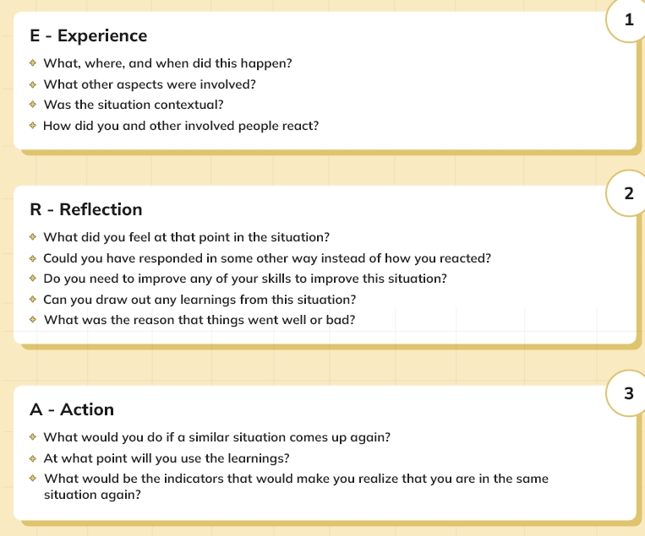
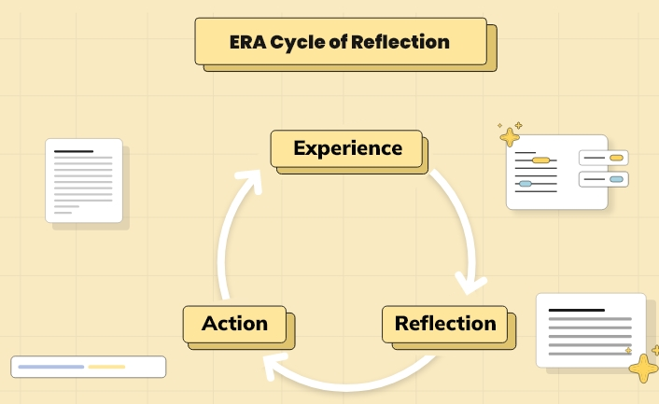
Era Cycle of Reflection (Jasper 2013)
The ERA stands for Experience, Reflection, Action. This simple framework was developed by Jasper (2013) and is based around building understanding from experience. The key component is that of action, as this feeds learning through reflection forward into future experiences.
Notes:
Ruth

Slide 14
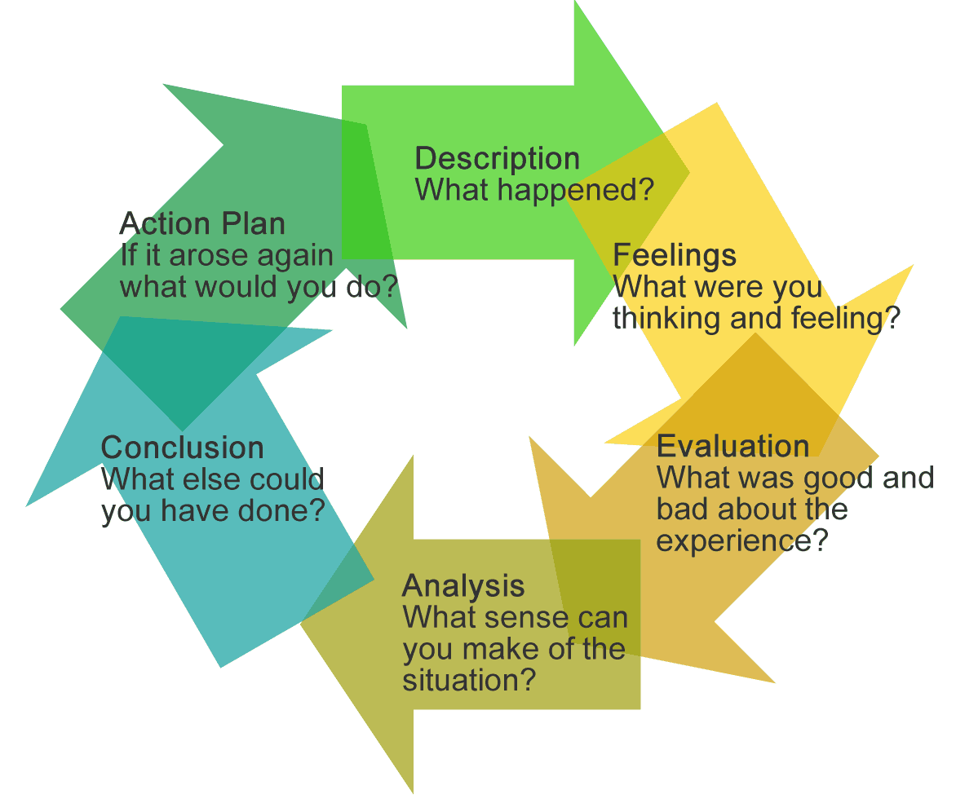
Gibbs (1988) model of reflection
One of the most famous cyclical models of reflection leading you through six stages exploring an experience:
Description of the experience
Feelings and thoughts about the experience
Evaluation of the experience, both good and bad
Analysis to make sense of the situation
Conclusion about what you learned and what you could have done differently
Action plan for how you would deal with similar situations in the future, or general changes you might find appropriate.
Notes:
Ruth

Slide 15
Thinking critically about reflective models
Pros
Offer a structure to be followed
Provide a useful starting point for those unsure where to begin
Allow you to assess all levels of a situation
You will know when the process is complete
Cons
Imply that steps must be followed in a defined way
In the real world you may not start 'at the beginning'
Models may not apply in every situation
Reflective practice is a continuous process
Notes:
Maya

Slide 16
Social Identity
Social identity relates to who we are in the context of (constructed) group membership which is often defined by some physical and social, characteristics of individuals
Everyone has multiple and overlapping social identities and important to hold in mind that the overlap (i.e. intersect) of these identities, create a unique experience
Often those with “normative” or centred identities aren’t actively aware of how the world engages with that identity i.e. binary and cis gendered, heteronormality, Whiteness, able-bodied etc
Notes:
Tansy

Slide 17
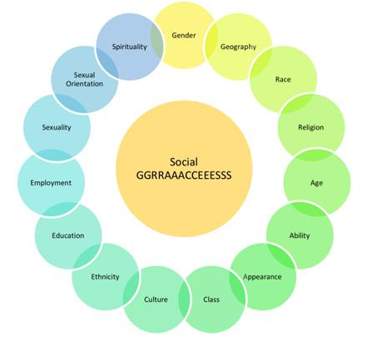
Social GRACES (Burnham, 2012)
One of the key aims of the graces is to ‘name’ power differentials. In doing so, it is far easier to identify (and work on) our own prejudice, or indeed on our own privilege.
The graces in this image are not exhaustive. They could differ according to place, time and culture. That’s the beauty of the graces; they are fluid. There is room for reflection and correction.
“The graces are about process, not procedure. It’s about the interaction between people, not data.”
A useful tool of reflection. Useful to use in interview
Notes:
Tansy

Slide 18
Relating this to the dclin interview..
There is not always representation on the panel
(though courses are working on this)
It’s possible your experiences may not be shares
You may feel judged or misunderstood
May experience a low-level threat response (both to the interview itself but
also navigating the process as a person from a marginalised community)
Feeling discomfort around talking about issues of race and racism to an
all White panel
Wanting to conform
Becoming someone you’re not in an interview to ‘fit the mould’
Notes:
Tansy

Slide 19
“Caring for myself is not self-indulgence, it is self-preservation, and that is an act of political warfare”
- Audre Lorde, 1988.
Notes:
Sometimes quotes are really academic so we wanted to share some more human quotes with you
Nat

Slide 20
“Rest is revolutionary.
Self care and community care are soul food.
Dancing and singing in the midst of everything that pulls you to disconnect from yourself is radical.
Spiritual practices are fuel for the journey ahead.
May we restore.” - Dr Thema, 2020
Notes:
Nat

Slide 21
What do to in interviews
CONNECT – vulnerability takes courage, but vulnerability is often what connects us – you choose though what you want to share
Hold in mind, are usually more similar than we are different
Your values will match the panel even if your social identity does not
Our differences are what makes life work – your differences are what makes you unique like a piece of a puzzle
YOU are needed in the profession so SELL why you are needed in the profession
Your experiences are unique therefore your experiences make you stand out
You have CHOICE. Always
It’s okay to be critical of psychology – use curiosity. Be a critical friend
Notes:
Tansy

Slide 22
Q&A
Trainees
Notes:
Nat

Slide 23
Q&A
Staff
Notes:
Nat

Slide 24
THANKS!
Please keep this slide for attribution

