Slide 1
Rupture and Repair
Dr Tansy Warrilow, Ruth Akindele and Maya Loonat

Slide 2

What makes a healthy relationship?
Before we start, can everyone take a minute to think about what nature/features make a healthy (professional) relationship?

Slide 3
What is Rupture?
Rupture can be defined as a breakdown, tension or tear in the mentor-mentee relationship, which can cause the quality of the working relationship to be adversely affected (Safran et al., 2009; Talbot et al., 2019).
Safran, J. D., Muran, J. C., & Proskurov, B. (2009). Alliance, negotiation, and rupture resolution (pp. 201-225). Humana Press.
Talbot, C., Ostiguy-Pion, R., Painchaud, E., Lafrance, C., & Descôteaux, J. (2019). Detecting alliance ruptures: the effects of the therapist's experience, attachment, empathy and countertransference management skills. Research in psychotherapy (Milano), 22(1), 325. https://doi.org/10.4081/ripppo.2019.325

Slide 4
Have you experienced a Rupture?
Rupture may be an unfamiliar word but the experience isn’t unfamiliar.
Has anyone here ever experienced a relationship rupture?
What does it feel like when there is a rupture in a relationship?

Slide 5


Possible sources of Rupture
Miscommunication/Mismatched expectations
  Time commitments
  Quality of feedback
Issues related to race/ethnicity/culture
  Ignorance of issues related to race/ethnicity/culture
  Discrimination/bias
Normally developing conflicts
  Arguments that can lead to miscommunication
  Cancelled meetings
Problems of interpersonal dynamics
  Personality differences
  Different views on a topic
SWatkins Jr, C. E., Hook, J. N., DeBlaere, C., Davis, D. E., Van Tongeren, D. R., Owen, J., & Callahan, J. L. (2019). Humility, ruptures, and rupture repair in clinical supervision: A simple conceptual clarification and extension. The Clinical Supervisor, 38(2), 281-300.

Slide 6


What does Rupture look like?
Rupture can be categorised into two types of reactions:
Confrontation or Withdrawal
Newhill, C. E., Safran, J. D., & Muran, J. C. (2003). Negotiating the therapeutic alliance: A relational treatment guide. Guilford Press.
Watkins Jr, C. E. (2019). Ruptures in the supervisory alliance. Supervision in psychiatric practice: Practical approaches across venues and providers, 299-304.

Slide 7

Confrontation
Confrontation is defined as movements against the other by expressing anger or dissatisfaction in a non-collaborative manner or through pressure and control.
Eubanks-Carter, C. F., Muran, J. C., & Safran, J. D. (2014). Rupture resolution rating system (3RS): Manual
Muran, J. C., Eubanks, C. F., & Samstag, L. W. (2021). One more time with less jargon: An introduction to “Rupture Repair in Practice”. Journal of Clinical Psychology, 77(2), 361-368.
Talbot, C., Ostiguy-Pion, R., Painchaud, E., Lafrance, C., & Descôteaux, J. (2019). Detecting alliance ruptures: the effects of the therapist’s experience, attachment, empathy and countertransference management skills. Research in Psychotherapy: Psychopathology, Process, and Outcome, 22(1)..

Slide 8
Confrontation Rupture Markers
  Hostile complaints about the mentor, mentee or mentoring.
  Hostile complaints about the mentoring schedule/agreement.
  Hostile complaints about the mentoring activities.
  Hostile complaints about the the progress or lack of progress within the mentoring.
  Mentee tries to pressure/control their mentor or mentoring.
  Mentor or mentee rejects mentoring.
Eubanks-Carter, C. F., Muran, J. C., & Safran, J. D. (2014). Rupture resolution rating system (3RS): Manual
Muran, J. C., Eubanks, C. F., & Samstag, L. W. (2021). One more time with less jargon: An introduction to “Rupture Repair in Practice”. Journal of Clinical Psychology, 77(2), 361-368.
Talbot, C., Ostiguy-Pion, R., Painchaud, E., Lafrance, C., & Descôteaux, J. (2019). Detecting alliance ruptures: the effects of the therapist’s experience, attachment, empathy and countertransference management skills. Research in Psychotherapy: Psychopathology, Process, and Outcome, 22(1)..

Slide 9

Withdrawal
Withdrawal is defined as movements away from the other by moving towards isolation, such as going silent or pivoting away with another topic.
Eubanks-Carter, C. F., Muran, J. C., & Safran, J. D. (2014). Rupture resolution rating system (3RS): Manual
Muran, J. C., Eubanks, C. F., & Samstag, L. W. (2021). One more time with less jargon: An introduction to “Rupture Repair in Practice”. Journal of Clinical Psychology, 77(2), 361-368.
Talbot, C., Ostiguy-Pion, R., Painchaud, E., Lafrance, C., & Descôteaux, J. (2019). Detecting alliance ruptures: the effects of the therapist’s experience, attachment, empathy and countertransference management skills. Research in Psychotherapy: Psychopathology, Process, and Outcome, 22(1)..

Slide 10
Withdrawal Rupture Markers
  Silence or offering minimal answers to questions that are intended to initiate or continue discussion during mentoring.
  Changing subject or being excessively compliant to avoid ‘ruffling feathers’.
  Abstract communication or vague language.
  Exhibiting boredom during mentoring.
  Exhibiting self-criticism and/or hopelessness.
  Exhibiting Denial.
Eubanks-Carter, C. F., Muran, J. C., & Safran, J. D. (2014). Rupture resolution rating system (3RS): Manual
Muran, J. C., Eubanks, C. F., & Samstag, L. W. (2021). One more time with less jargon: An introduction to “Rupture Repair in Practice”. Journal of Clinical Psychology, 77(2), 361-368.
Talbot, C., Ostiguy-Pion, R., Painchaud, E., Lafrance, C., & Descôteaux, J. (2019). Detecting alliance ruptures: the effects of the therapist’s experience, attachment, empathy and countertransference management skills. Research in Psychotherapy: Psychopathology, Process, and Outcome, 22(1)..

Slide 11
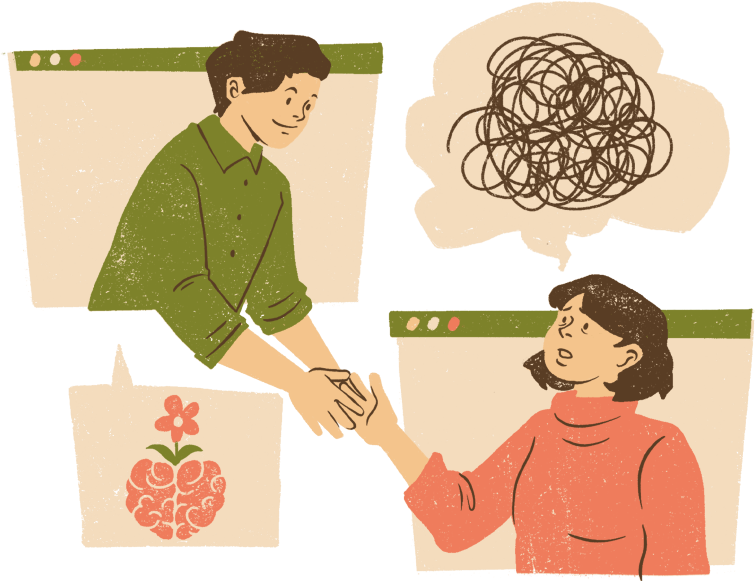
Rupture Repair
Rupture Repair is when efforts are made to resolve and fix the rupturing event and to restore the relationship to a good working order.
There are two basic steps involved in repairing a ruptured relationship:
  bringing up the rupture issue for discussion.
  discussing it openly with your mentor/mentee.
Opening up discussion about the rupture and collaboratively processing the rupture - are central to increasing the likelihood of successful rupture repair.
Ladany, N., Friedlander, M. L., & Nelson, M. L. (2005). Critical events in psychotherapy supervision: An interpersonal approach. American Psychological Association.Watkins Jr, C. E. (2021). Rupture and rupture repair in clinical supervision: some thoughts and steps along the way. The Clinical Supervisor, 40(2), 321-344.
Watkins Jr, C. E., Hook, J. N., DeBlaere, C., Davis, D. E., Van Tongeren, D. R., Owen, J., & Callahan, J. L. (2019). Humility, ruptures, and rupture repair in clinical supervision: A simple conceptual clarification and extension. The Clinical Supervisor, 38(2), 281-300.

Slide 12

Repairing the Ruptured Relationship
Tips for repairing the ruptured relationship:
  Humility is a critical variable in the rupture repair process - the foundation for any and all rupture repair.
  Apology is defined as one potentially effective rupture intervention - Watkins et al. (2015).
  Humility and genuine concern for the mentor/mentee increases the likelihood of apology effectiveness, whereas a lack of humility and genuine concern increases the likelihood of apology failure - Watkins et al. (2015).
Watkins Jr, C. E. (2021). Rupture and rupture repair in clinical supervision: some thoughts and steps along the way. The Clinical Supervisor, 40(2), 321-344.
Watkins Jr, C. E., Hook, J. N., DeBlaere, C., Davis, D. E., Van Tongeren, D. R., Owen, J., & Callahan, J. L. (2019). Humility, ruptures, and rupture repair in clinical supervision: A simple conceptual clarification and extension. The Clinical Supervisor, 38(2), 281-300.
Watkins, Jr, C. E., Reyna, S. H., Ramos, M. J., & Hook, J. N. (2015). The ruptured supervisory alliance and its repair: On supervisor apology as a reparative intervention. The Clinical Supervisor, 34(1), 98-114.

Slide 13
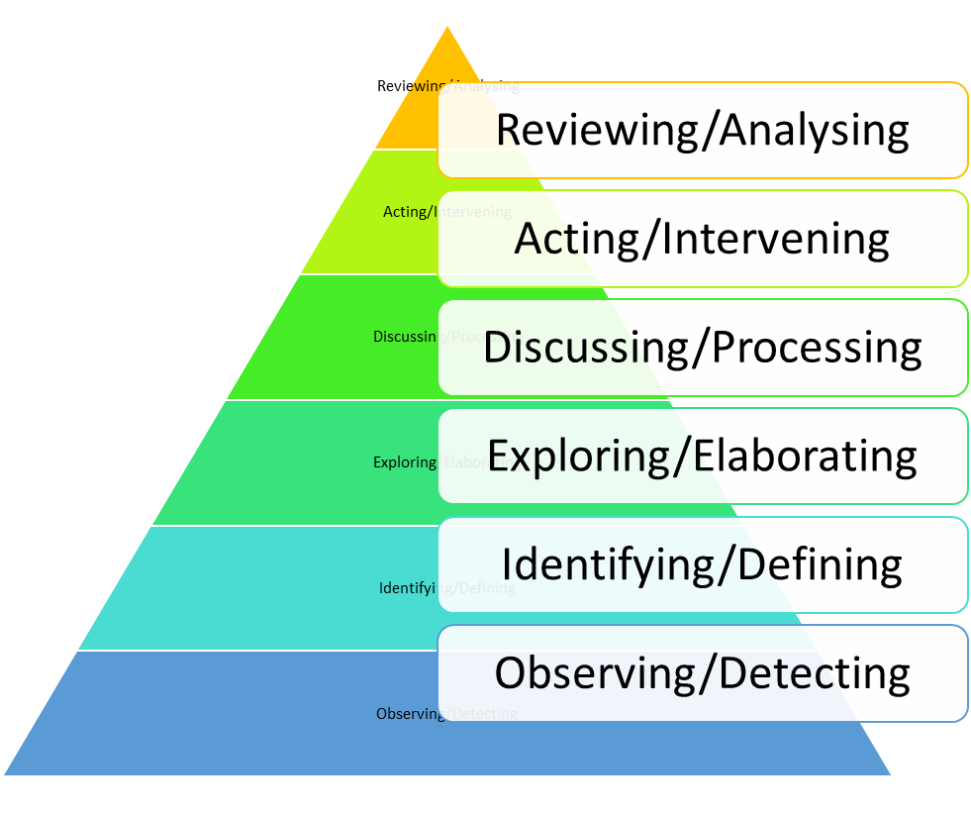
Rupture/Repair Process
Additional steps of action and analysis have been identified and can aid in the rupture repair process. The pyramids six steps capture a logical conflict resolution flow.
Remember the steps may be simple, but rupture repair can be messy, difficult and far from simple.
Watkins Jr, C. E. (2021). Rupture and rupture repair in clinical supervision: some thoughts and steps along the way. The Clinical Supervisor, 40(2), 321-344.

Slide 14
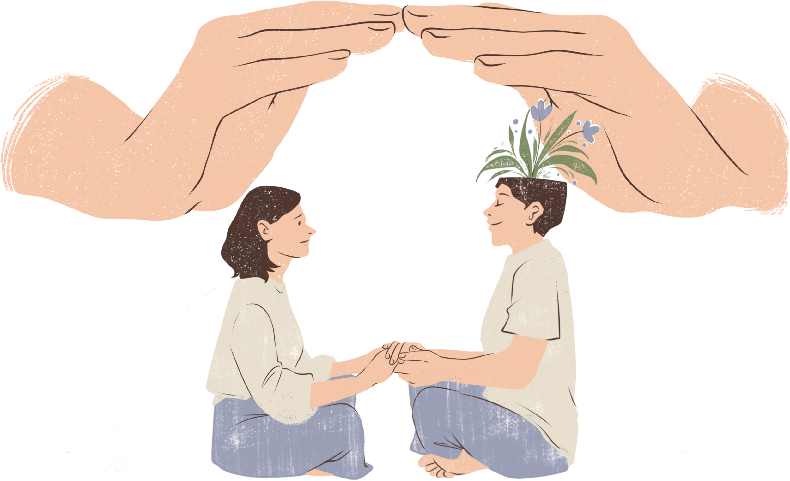
Rupture and Repair Stages
Observing/Detecting
  When confrontation rupture reactions arise, avoid becoming defensive.
  Respond to potential withdrawal with curiosity - ‘What do I see happening in the mentoring relationship?’ ‘What might be the cause of these changes?’.
Identifying/Defining
  Readily recognise the rupture has occurred.
  Determine its nature/features - ‘Tell me what has happened, I want to know’.
Exploring/Elaborating
  Fully explore the rupture.
  Understand the meaning of this rupture - ‘I want to understand’ ‘Is there anything unsaid you wish to say?’.
Watkins Jr, C. E. (2021). Rupture and rupture repair in clinical supervision: some thoughts and steps along the way. The Clinical Supervisor, 40(2), 321-344.

Slide 15

Rupture and Repair Stages
Discussing/Processing
  Be willing to process with mentor/mentee in as much details as is needed to remedy the relationship.
  Do not rush the process!
Acting/Intervening
  Apologise.
  Low quality apologies (rushed, insincere, dismissive) can lead to further relationship deterioration.
Reviewing/Analysing
  Scrutinise own efforts made to repair the relationship and their effects.
  what else is needed to restore the relationship.
  Self-analyse and collaborate analysis is required.
Watkins Jr, C. E. (2021). Rupture and rupture repair in clinical supervision: some thoughts and steps along the way. The Clinical Supervisor, 40(2), 321-344.

Slide 16
Discussion

