Slide 1


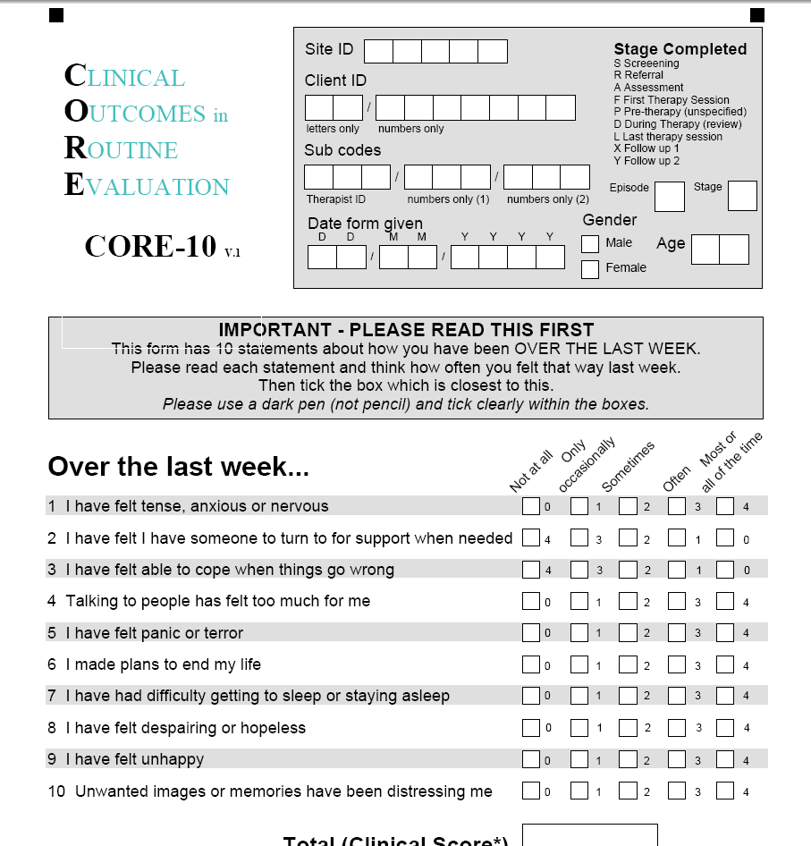
Leeds DClin Supervisor Update
Systematic Case Methodology
Rebecca Dalby, Ciara Masterson and Beckie Yeates

Slide 2
Aims
To briefly introduce/refresh purpose of group of methodologies called Single Case Experimental Designs (SCED)
To share how the Leeds Dclin uses principles of SCED in our Systematic Case Study (SCS) assignment
Discuss top tips for supervising data collection phase of a SCS
Discuss common dilemmas and some potential solutions

Slide 3
Some perspectives / responses on SCS work
“It requires the use of a lot of irrelevant measures” |  | “It can only be used in structured therapy modalities”
 | Multiple levels of measurement are encouraged but the measurement should be specific and useful! |  | SCS can be used in any change-focused therapy, in fact it’s particularly useful in modalities where large numbers and identical delivery is not possible
“It distracts the therapist and client and is only for the benefit of the therapist” |  | “It is not suitable for my client group”
 | When integrated into therapy, it can enrichen insights in both therapists and clients about what therapeutic tools are leading to positive change |  | Change measures can be tailored to access needs. The only requirement is that the measure is objective and can measure change over time

Slide 4
Purpose of SCS: Measuring Change
Assessing change is a part of the culture in the NHS - whether and how a client improves as a result of treatment.
Closely measuring relevant changes – using a mixture of tools (not just global distress measures)
Systematic case studies can provide valuable information on the effectiveness and mechanisms of change from interventions.
An essential skill which helps us understand what really goes on in therapy, and to think critically and creatively about our practice.

Slide 5
Measuring Change in Individuals
Pre-Post Design
A basic RCT
Treatment vs Control
Pre Post
Treatment
Experiments with Single cases
Repeated measures
Different phases (conditions)
baseline
treatment
Sessions
Notes:
A pre-post design evaluates an intervention by taking two data points—one before (pre) and one after (post)—for a group. In contrast, single-case methodology tracks an individual or single system repeatedly over time, comparing outcomes across multiple phases (such as pre-treatment baseline and treatment) to establish a cause-and-effect relationship

Slide 6
Single-Case Experimental Designs
Involve a baseline period where there is no intervention – ideally achieving stable ratings in the relevant measure
Include experimental manipulation using some form of randomisation or systematic phase change to rule out plausible alternative explanations
Typically involves a combination of measures (standardised and idiosyncratic)
May involve replication over several cases to form a single-case series study
Can take place over various lengths of time (e.g., minutes, hours, days or weeks)
Notes:
Becks taking over

Slide 7
Simple A-B design
After Youell & McCullough, 1974

Slide 8
Systematic Case Study in Leeds DClin
Uses principles of SCED but ensures its viable for all trainees within routine practice
Completed by trainees on their 1st or 2nd placement
Summative research assignment
Trainees asked to identify cases that might benefit from close measurement / analysis of the process of change (not necessarily the best outcomes) at the outset of placement

Slide 9
Using the scientific method to evaluate change in therapy
Select measures
Plan observations
Analyse data
Interpret the analysis
Ask a question

Slide 10
What is the research question?
Common pitfall is collecting the data then working backwards
Should build on the literature in the area
Useful for evaluating a unique approach where RCTs aren’t appropriate/possible
Useful for identifying specific mechanisms of change within therapeutic modalities
Useful to identify improvements that are important to service and service user

Slide 11
What is the research question?
“Does [therapy modality] lead to significant changes in [treatment target] in [sample]?
“Why does my client seem to be so much better, and report achieving her goals on idiographic measures, when she shows no change on the nomothetic measures such as the CORE?”
“I’ve been working with my client on her anxiety, but has our work has impacted some of her other problems?”
“Has my therapeutic work helped this child adjust to her chronic illness?”
“My client has made huge progress. Was it something I did in therapy, or was it winning the national lottery?”

Slide 12
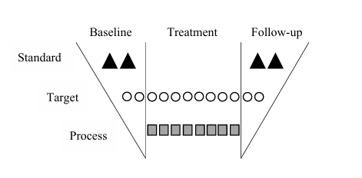
A rich case record: the Morley funnel

Slide 13
Rich case record is necessary for:
Hermeneutic single-case efficacy design​ (HSCED)
Utilises a variety of data from therapist and client:
  Quantitative standardised outcome data
  Weekly change data and
  Qualitative change data.
​
Aim:
Did the client change substantially over the course of the intervention?
If the client changed, did the intervention make a substantial contribution? Can we rule out non-intervention contributions?
If the client changed due to the intervention, what brought about those changes?

Slide 14
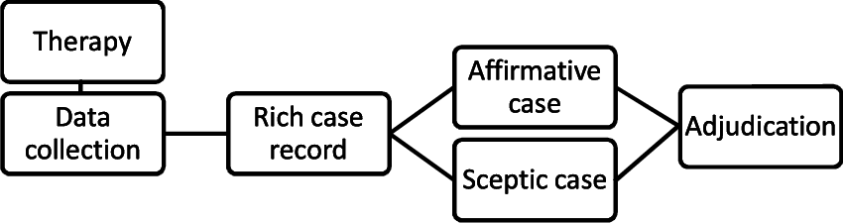
HSCED

Slide 15
A rich case record: the Morley funnel
deteriorated
Post tx
unchanged
recovered
Pre tx

Slide 16
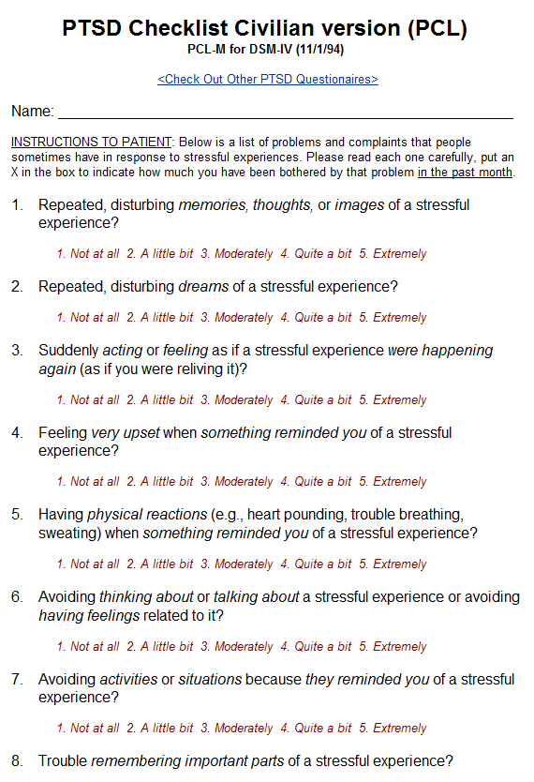
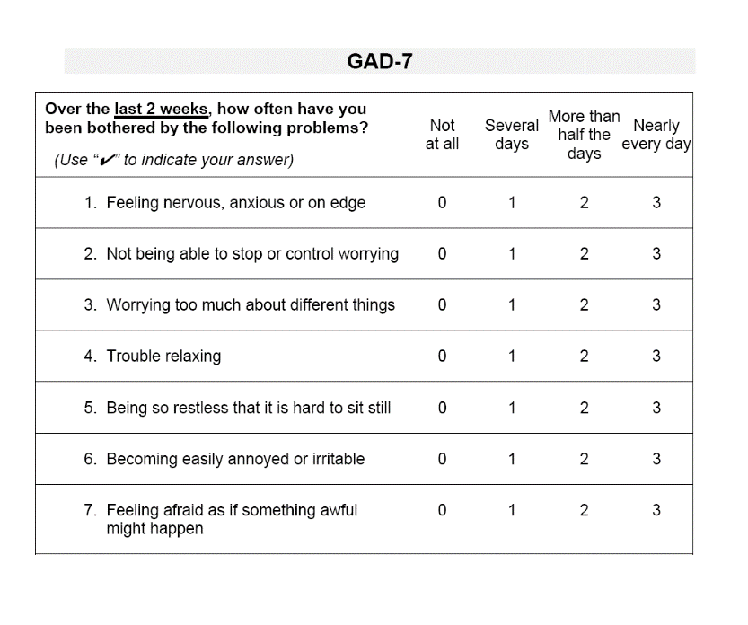
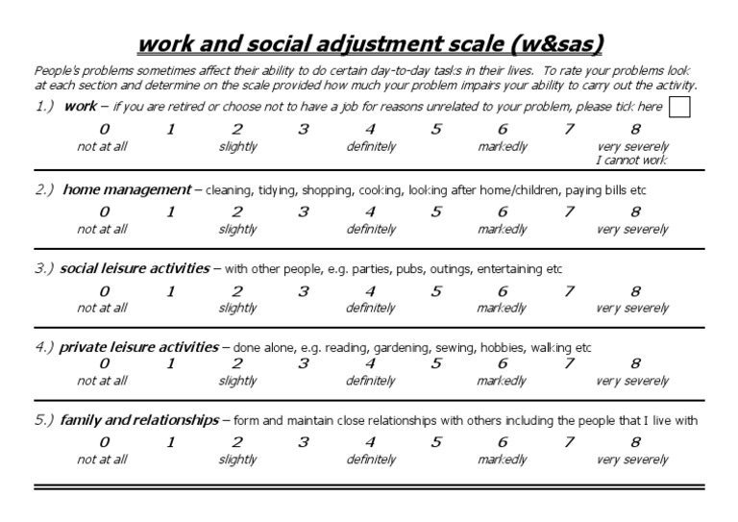
Standardised/Nomothetic Measures
Used to compare against population norms*
Answers “Has the client score changed to be closer to a non-clinical sample mean?”
E.g. CORE, GAD-7, RCADS
Notes:
*make sure norms are available at the start

Slide 17
A rich case record: the Morley funnel
baseline
treatment
follow up
......
. . . . . .
........

Slide 18
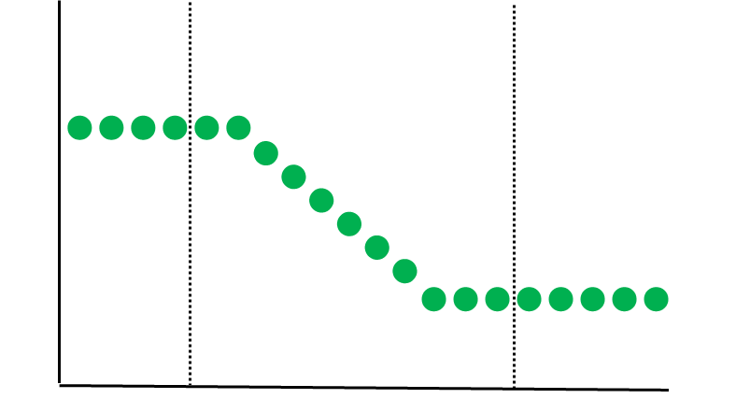
Target Measures: Standardised
Narrowing the focus from broad standardised outcome measures - specifically addressing individual problems
Can use standardised outcome measures previously stated, if appropriate (e.g. the IES-R)
Can be used to supplement standard outcome measures (see Sales et al. 2017: 71% reported at least one item not covered by CORE‐OM and 95% for PHQ-9)
But – consider frequency of measurement and burden to the client with longer questionnaires

Slide 19
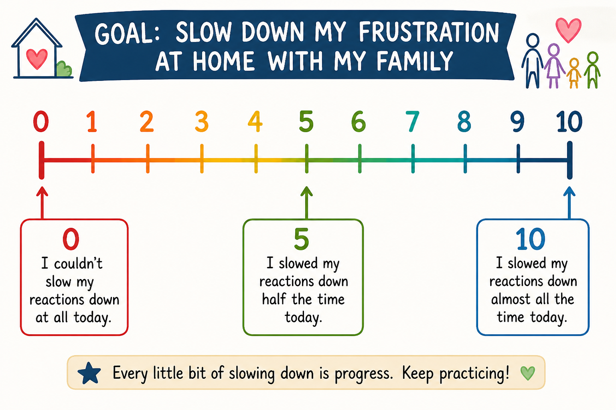
Target Measures: Idiographic
Matches the client’s goals
Created collaboratively with client
Can be used as part of the intervention
Includes:
  Diaries
  Activity records
  Behaviour counts
  Rating scales (e.g. VAS, SUDS)
  Visual tools
Can be creative, but must be objective and measurable

Slide 20
A rich case record: the Morley funnel

Slide 21
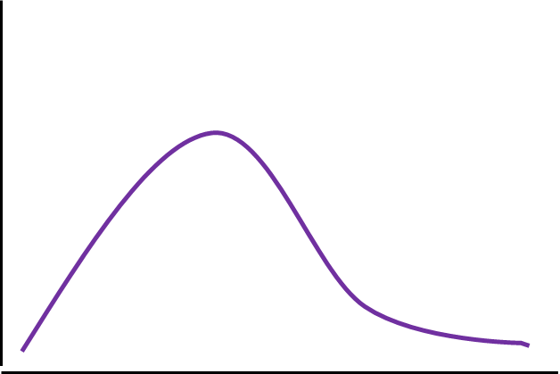
Process Measures
Understanding the process by which change occurs
Measured by:
Session Rating Scales
Therapeutic alliance scales
Theory based process measures
Therapeutic model adherence
Client change questionnaires/interviews
Therapist notes

Slide 22
Tops Tips: Before meeting client
Supervisors help trainees identify a client for change-focussed work (6+ sessions)
Hypothesise potential primary change target (clinical focus) and any secondary needs
Review recent measures – consider repeating those
Consider standard measures used by the service & think about what else could be added, bearing in mind burden to client
If initially unsure on focus, can use global measures (e.g. CORE-OM)

Slide 23
Top Tips: Initial assessment
Clarify clinical focus using recent assessment information
Share with client the potential benefits of repeated measurement, seek verbal consent to proceed
Identify shared treatment goals (SMART) – consider idiographic measures
If working with systems think about where change might be located/observed (e.g. care teams)
Consider how and when you want to measure change, make it intentional but feasible
Administer pre measurement/s before intervention occurs

Slide 24
Top Tips: During the work
Collect sessional measures & review adherence
Consider value of process notes
Alter measurement if needed (but try to retain at least one measure you have a pre measure for)
Use the data collected to enhance therapeutic work

Slide 25
Tips: At the end of the work
Re-administer measures taken at the start
Consider if there is enough data so far to be able to fulfil the SCS assignment (minimum requirements)
Gain client’s perspective on what changes have occurred and what contributed (client change interview)
Make anonymous notes of key case details which can assist with change analysis
Record consent for data to be used
Trainees will consult with academic tutor for support with analysis and write up.

Slide 26
A flexible method
Consider how to take advantage of naturally occurring waiting times to establish an experimental baseline (strengthens analytical insights)
Can be used for individuals attending a group programmes (but consider how measures may need to adapt)
Can take measurement from carers, parents, staff instead of/as well as the client
Can be used to evaluate the impact of an assessment process as long as there is a change target
Can even be done within single sessions where change can be measured across a period of minutes or between sessions where impact of homework is monitored daily

Slide 27
Benefits for you
Gain insights into change processes (e.g., locate timing / sizes) for your service clients which can inform your practice
Create practice-based evidence for innovative therapeutic practice and/or rare presenting problems
Findings from an N=1 SCS could act as a bridge to a larger case series where a group of clients with a similar difficulty are measured through an intervention to determine its effectiveness over time

Slide 28



