Slide 1
Introductory
Supervisor Workshops
2026
Day 3
Erica Milton, Kirsty Hughes, Tom Isherwood, Sarah Kent

Slide 2
Timetable – Day 3
09:00: Registration
09:30: Introduction and plan for the day
09:45: Leadership
10.45: BREAK
11:00: Sustainability
11:30: Creating a good placement experience – Getting the most out of your trainee
12:00: LUNCH
13:00: Creative method and Group Supervision
14.30: BREAK
15:00: Individual Action Plans, Portfolio Criteria and Submissions
15:45: Feedback on ISW programme
16:00: End
Notes:
Trialling £10 Food vouchers for lunch/day

Slide 3
Where are we up to
What have we covered so far
Post-its: What do you need before the end of the day?
Burning questions

Slide 4
Aims for the day
To consider issues of leadership on placement
To consider service user and carer involvement on placement
To consider issues of sustainability for trainees and within your services
To consider alternative methods in supervision
ISW: What next and action plans

Slide 5
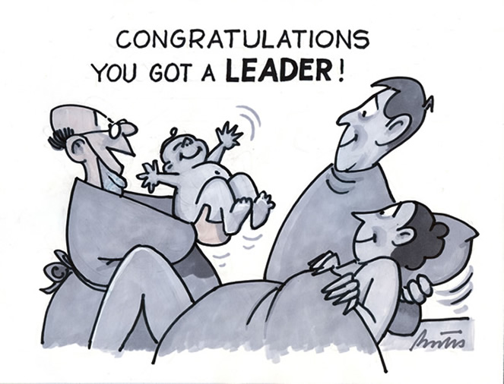
Leadership

Slide 6
Aims
Experiences of leadership
Leadership within relationships
Types of Leadership
Leadership frameworks
Leadership in Training
Notes:
Reflections on your experiences of leadership
Thinking about leadership in terms of relationships
Considering different types of leadership
NHS and DCP leadership frameworks
Thinking about the training context: Linking this to trainee competencies on placement

Slide 7
Experiences of Leadership
When have you felt most effectively led or managed?
  What did the person actually do?
  What impact did it have on your thinking, feelings, performance?
Notes:
We want to start with your reflections and a discussion about what Leadership looks like.
Getting us to consider our understanding of relationships, power, and influence.
Reflecting on our own experiences of leadership: Being led, managed; Leading, influencing
2mins Find an example
6mins Discuss in pairs
2mins Feedback themes to group

Slide 8
Experiences of Leadership
Consider a recent situation where you influenced something at work (individual, team, organisational)
  What seemed to help others engage, trust, or follow?
Notes:
Individual: influencing a service user, family, or colleague
Team: influencing colleagues, MDTs, or team culture
Organisation/System: influencing service development, policy, pathways, or wider NHS priorities
2mins Find an example
6mins Discuss in pairs
2mins Feedback themes to group

Slide 9
Leading through relationships
Dispersed Leadership
Compassionate Leadership
Inclusive Leadership
Notes:
Lots of different ‘types’ of leadership. Focus on relationships.

Slide 10
Dispersed Leadership
Less formalised model of leadership
The leaders’ role is dissociated from the organisational hierarchy
Individuals at all levels in the organisation and in all roles can exert leadership influence over their colleagues
“Leadership” is regarded as a process of sense-making and direction-giving
Leader as emergent rather than predefined
Allows more people to grow as leaders
Notes:
-Referred to as ‘informal’, ‘emergent’ or ‘dispersed’ leadership.
-This approach is a less formalised model of leadership where the leaders’ role is dissociated from the organisational hierarchy.
-‘Dispersed leadership’ came about through the realisation that no one individual is the ideal leader in all circumstances.
-That individuals at all levels in the organisation and in all roles (not simply those within management) can have leadership influence over their colleagues and thus influence the overall leadership of the organisation.
-The key to this is a distinction between the notions of “leader” and “leadership”.
-“Leadership” is regarded as a process of sense-making and direction-giving within a group
-The “leader” can only be identified by their relationship with others in the group who are behaving as followers.
-The leader, then, is not predefined but rather emergent.
-This is a move to understanding Leadership through relationships within groups within an organisation (rather than by focussing on an individual’s personal characteristics or traits).
Examples:
-Our team as a model, allows people to grow more as leaders and can be more effective than a hierarchical one
-Kirsty to talk about Beyond

Slide 11
Compassionate Leadership
4 Behaviours:
Attending
Understanding
Empathising
Helping
4 Elements:
  inspiring vision and strategy
  positive inclusion and participation
  enthusiastic team and cross-boundary working
  support and autonomy for staff to innovate
Notes:
-Compassionate leadership is fundamentally rooted in relationships.
-It focuses on relationships through listening to, understanding, empathising with and supporting other people, so that those who lead feel valued, respected and cared for. This helps people reach their potential and do their best work.
-There is evidence that compassionate leadership results in more engaged and motivated staff with higher levels of wellbeing, which in turn results in high-quality care (West 2021).

Slide 12
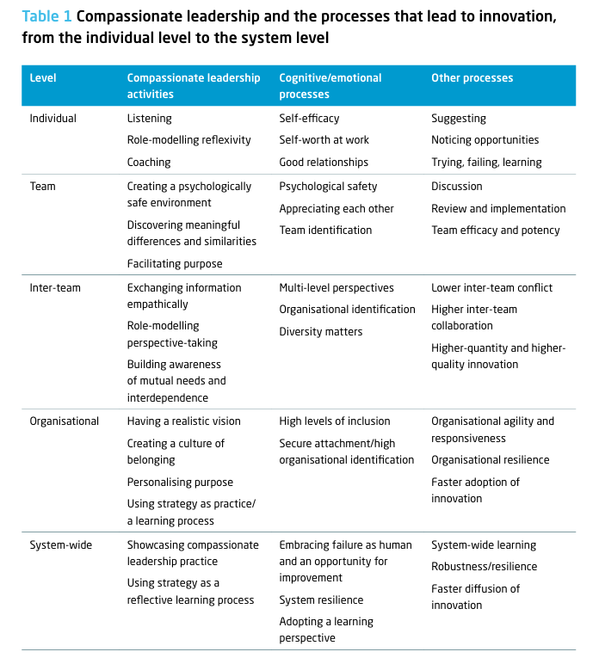
Caring To Change And Compassionate Leadership | The King's Fund
Notes:
Impact of compassionate leadership at different levels: Individual, Team, Organisational, and System wide

Slide 13
Caring To Change And Compassionate Leadership | The King's Fund
Notes:
Impact of compassionate leadership at different levels: Individual, Team, Organisational, and System wide

Slide 14
Psychological Safety (West, 2018)
Shared Vision, Values and Objectives
Reflexivity, Innovation and Learning
Frequent, Positive Contact
Valuing diversity, difference and conflict
Mutual Support, Compassion and Humility
Compassionate Leadership/Effective Team Working
Trust
Notes:
-West (2018) found that Psychological safety is a core component for compassionate leadership to reduce workplace stress and drive high performance, particularly in healthcare settings like the NHS (NHS Staff Survey data).
-As a leader if you are helping people learn and grow they need to feel safe – need both governance and relational aspects
-People will follow people who they feel safe with and trust

Slide 15
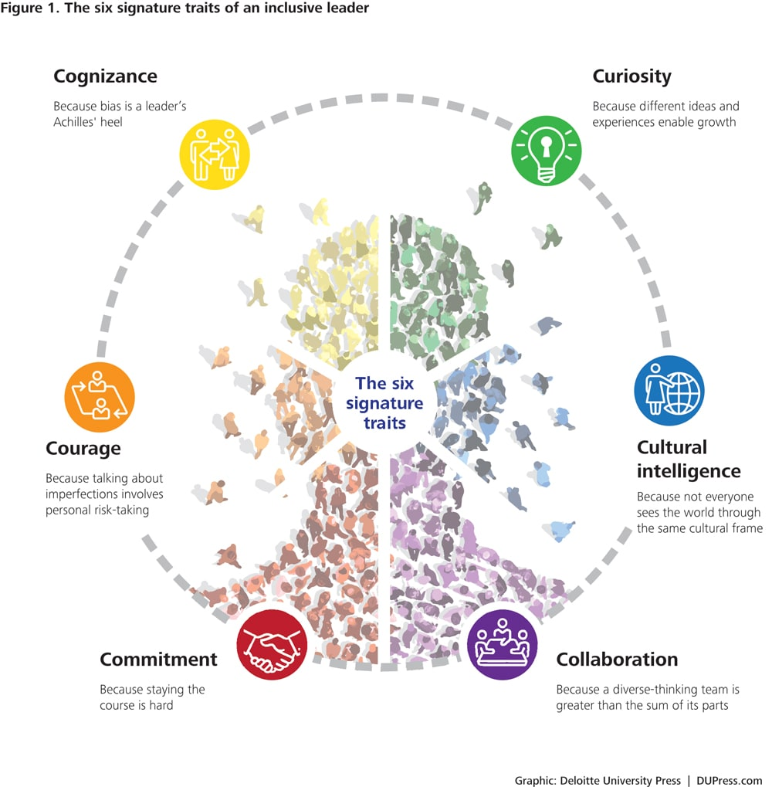
Inclusive leadership
Notes:
The 6 C's of inclusive leadership are core traits that help managers foster fairness, belonging, and diverse perspectives.
Commitment: Working in line with values aligned to diversity and inclusion.
Courage: Admitting personal limitations, being humble, and speaking up to challenge the status quo or address unfair practices.
Cognizance of Bias: Remaining aware of potential blind spots, then actively trying to manage this.
Curiosity: Keeping an open mind and showing a genuine desire to understand how others experience and view the world.
Cultural Intelligence: Being confident and effective in cross-cultural interactions, while adapting your style to respect different backgrounds.
Collaboration: Empowering diverse-thinking team members, and fostering psychological safety

Slide 16
The Leader:
Knowledge, Skills
Attributes, Experiences
The Followers: Knowledge, Skills, Attributes, Experiences
The Context: Goals, Tasks, Group, Organisation, Culture
RELATIONSHIPS

Slide 17
Reflective Exercise
Core Values & Beliefs
Life Experiences & Roles (personal, clinical, organisational)
Social Identities (e.g., race, gender, class, education, culture)
What values guide how I lead?
What life experiences shaped my approach to leadership?
What social identities influence how I am seen, and how I see others, as a leader?
Notes:
10 min
Bringing this back to you.
- What is important to you?
- Consider what may influence your identity as someone who can influence and ‘lead’
Group reflection on process, how did you find doing this? Is there anything that surprised you?
Credit to Jan for Exercise.

Slide 18
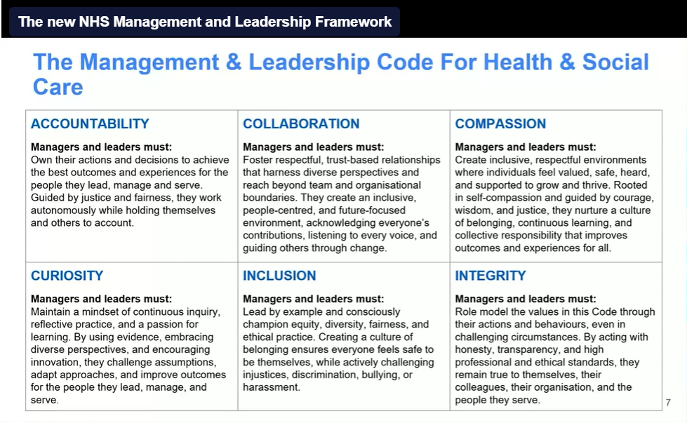
Developing the NHS Leadership and Management Framework | NHS Employers
Notes:
The new NHS Leadership framework
-Digital transformation is reshaping NHS management. Leaders embrace technology and data-driven strategies.
-Workforce wellbeing and inclusivity are prioritised, requiring supportive and diverse leadership approaches.
-Sustainability is increasingly vital, with leaders expected to address environmental impact and implement green practices across NHS operations.

Slide 19
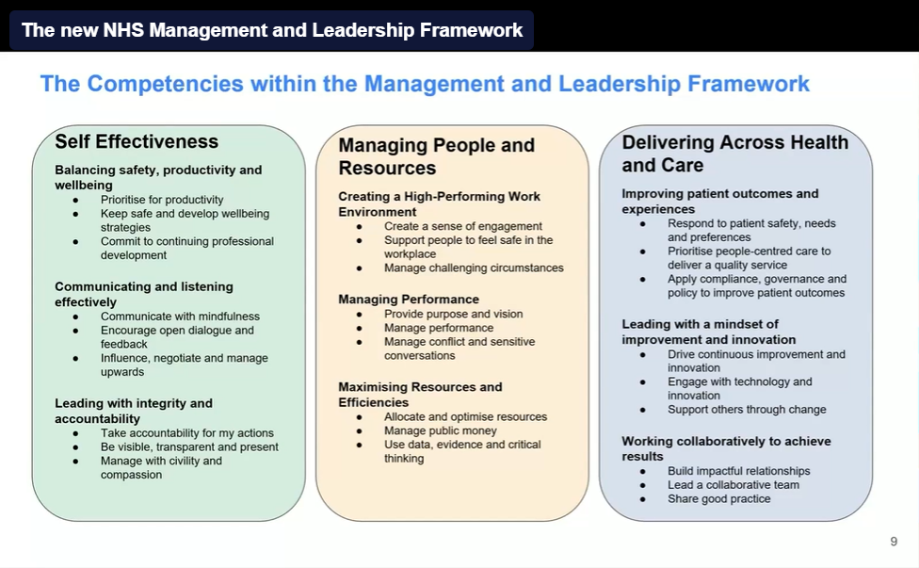
Developing the NHS Leadership and Management Framework | NHS Employers
Notes:
The new NHS Leadership framework
-Digital transformation is reshaping NHS management. Leaders embrace technology and data-driven strategies.
-Workforce wellbeing and inclusivity are prioritised, requiring supportive and diverse leadership approaches.
-Sustainability is increasingly vital, with leaders expected to address environmental impact and implement green practices across NHS operations.

Slide 20
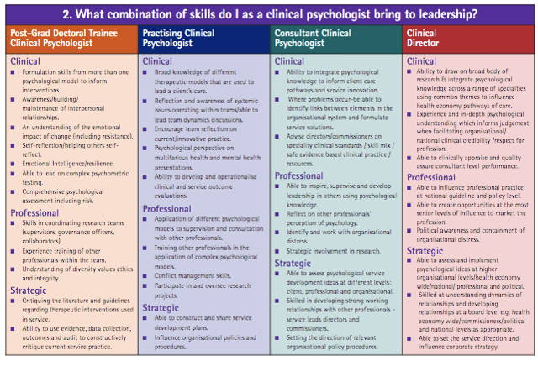
DCP Leadership Competencies Framework Review
Notes:
DCP Leadership Competencies Framework (2010) – To support leadership development for clinical psychologists. To guide reflective practice, career development, and leadership identity
Update 2026 – to align with NHS & HCPC

Slide 21
BPS accreditation
Required outcome 7
By the end of Programme, trainees will have developed:
The skills, knowledge and values to work in a range of indirect ways to improve psychological aspects of health and healthcare. This includes leadership skills and competencies:
Consultancy
Supervision
Teaching and training
Working collaboratively
Influencing psychological mindedness and practices of teams.
Notes:
Linking back to training – Trainees need opportunities to develop these skills, as required for BPS accreditation

Slide 22
Learning Objective 10: Organisational and systemic influence and leadership
The trainee should be able to:
Demonstrate an awareness of the legislative and national planning contexts for service delivery and clinical practice and an understanding of the organisation in which the placement is based
Work with service users and carers to facilitate their involvement in service planning and delivery
Indirectly influence service delivery through working effectively in multidisciplinary and cross-professional teams and consultancy
Demonstrate leadership qualities e.g. being aware of and working with interpersonal processes, proactivity, influencing the psychological mindedness of teams and organisations, contributing to and fostering collaborative working practices within teams
Recognise malpractice or unethical practice in systems and organisations and know how to respond to this; be familiar with ‘whistleblowing’ policies and issues.
Notes:
PAF Competency #10

Slide 23
Leadership in context: Exercise
Leadership, influencing and ‘followership’ will take different forms in different contexts
What is one thing a trainee should observe in order to learn about leadership and influence in your team?
What is one thing a trainee should engage in to develop their capacity to lead and influence?
Notes:
10min
Groups of 4
-What are the opportunities for trainees to do L/leadership work at their place of work (examples on next slide)
Feedback to group (top pick and why they selected it, why it would be a good example for a trainee)

Slide 24
Some examples from training
Experiences have come from a wide variety of settings including CAMHS, Child Health, Adult CMHT, Clinical Health, Neuropsychology, People with a Learning Disability, Forensic, Older People Services, Public Health
  Teaching/Training
  Consultation
  Reflective Practice
  Service evaluation/Audit
  Leading assessments
  Co-facilitating groups
  Chairing meetings
  Supervision of others
  Team formulation
  Attending governance meetings
Notes:
These are examples of work that trainees have been involved with on their placements.
Organisational/system-wide examples?

Slide 25
Next steps
What is one leadership behaviour that I want to carry forward from today?
What is something I want to leave behind?
Notes:
5mins

Slide 26
Resources
What Is Compassionate Leadership? | The King's Fund
Caring To Change And Compassionate Leadership | The King's Fund
Six signature traits of inclusive leadership | Deloitte Insights
Developing the NHS Leadership and Management Framework | NHS Employers
Clinical Psychology Leadership Development Framework | BPS - British Psychological Society

Slide 27
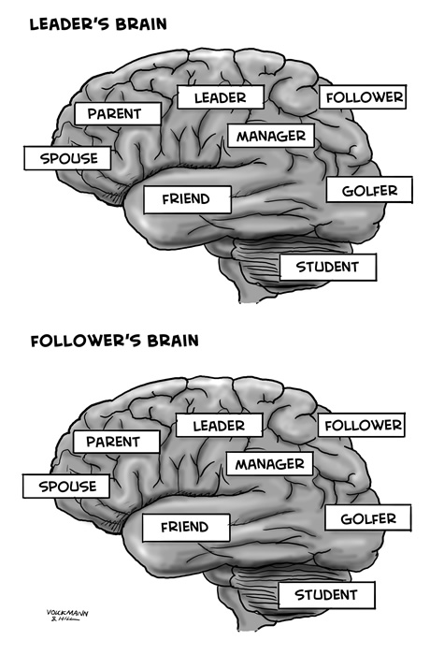
BREAK
Notes:
10:45

