Slide 1
Introductory
Supervisor Workshops
2026
Day 3
Sarah Kent, Erica Milton, Kirsty Hughes and Tom Isherwood
Notes:
Kirsty available all day
Erica – available up to 10.45 and 12.15-2.15
Sarah K – available from 2.30pm

Slide 2
Portfolio
To include:
Learning objectives self-evaluation questionnaire (including the personal learning objectives) x2.
Reflective log containing 3 x 500-word personal accounts (these should include an example/examples from your supervisory practice).
A copy of the peer supervision group contract.
Structured feedback received from someone you have supervised during the course of ISW (SSRQ x2 and/or LASS x 6)
Feedback from your supervisor of supervision at two time points: after the day one and after day three.
Commentaries (on contract, structured supervisee feedback and supervisor feedback) and priorities for further development
Please see the ISW pack for the relevant documents within the appendices
Notes:
Self evaluation should be pre- and post- training
Reflective log topics:
An issue of difference and diversity
The relevance of a theoretical model of supervision
An ethical aspect of supervisory practice.
The supervisor who supervises your supervision must confirm that they have reviewed a recording of you providing supervision at each time point and discussed this with you.

Slide 3

Submission Deadlines
End of October – feedback in November
End of January – feedback in February
End of May – feedback in June

Slide 4
Action Plans
Review what you have learnt over the course of ISW
What are your ongoing development needs?
Consider your learning in the next six months
Plan what steps you can actively take to ensure this learning occurs
Notes:
3.45 conclude
-Work towards PBL
-supervise someone
-Do bits of portfolio (e.g., reflective bits)

Slide 5

What Next?
The Supervisor Register
Offering placements (please)!

Slide 6
Ways to Stay Connected
Selection shortlisting.
Subcommittees.
ASW and PQT.
All the Mentoring options.

Slide 7

Questions?

Slide 8
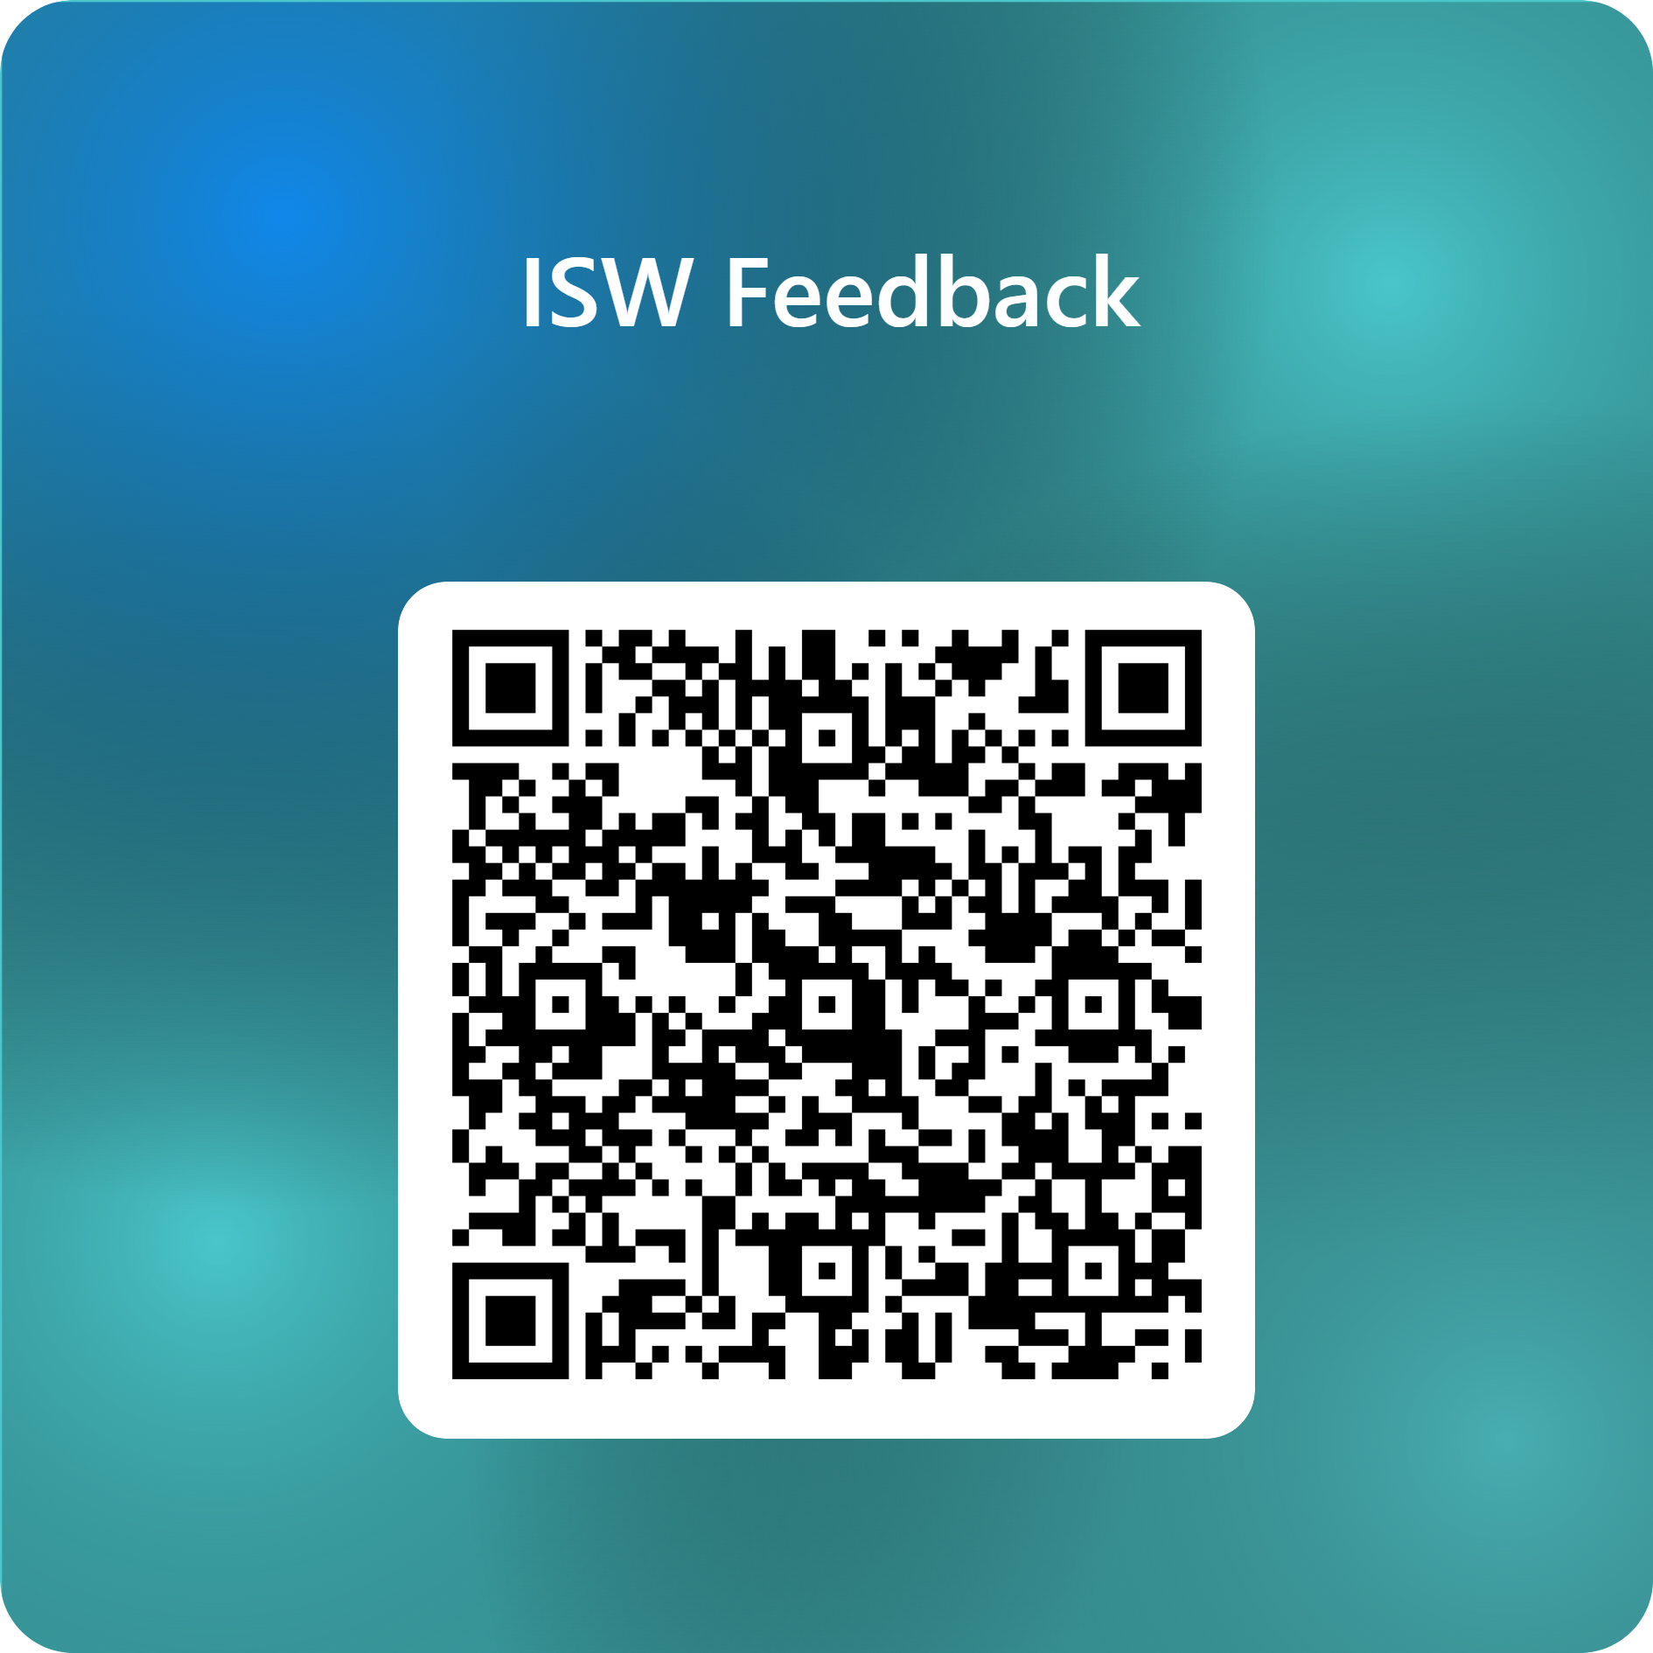
ISW Feedback – Fill in form

